Slide 1
Endpoint Privilege Management
Overview of challenges and solution

Slide 2
Introduction
Challenges for administrative privileges within the modern workspace

Slide 3
Why do we need admin privileges
Providing support to end-users
(Occasionally) Install applications
Let users do configuration changes themselves, which may require admin privileges/run as admin (IT Tech Workers & Developers)

Slide 4
Administrators on Azure AD joined devices
By default, the following users have administrator permissions in AAD joined devices
Global Administrator accounts are administrator on all managed devices in the tenant
Only a few GA’s should be in the tenant
Not a good practice to use these accounts for support or local admin privileges
Device Administrators are administrator on all managed devices in the tenant
Need to be configured on a per-user level
All or nothing
The user enrolling a device with Autopilot becomes administrator when configured in the Autopilot (user driven) profile
Difficult to manage, may need a different profile for (per example) developer devices
Only set on enrollment
The user joining a device to AAD (manually) will become Administrator on the device
We typically do not support manual joining devices to AAD

Slide 5
Administrators on Azure AD joined devices
Challenges
We cannot use (AAD-)groups to configure administrators
We cannot target individual devices easily (compare item-level targeting in AD GPO)
All or nothing:
We cannot (easily) monitor actions done by administrators
No time or session limitation
Vulnerable for malware and other malicious software or attacks

Slide 6
Alternatives
Add users to the local / built in group ‘Administrators’
Running a script, PowerShell from Intune or the SSW Application portal*
Intune Custom Device Configuration (Policy CSP)
Hard to manage, not suitable for configuring permissions with end-user targeting
Enable the local (built-in) Administrator account
Difficult to keep the password secret
Using one password on all devices is a security risk
Using a per-device password is a lot of management overhead, maybe impossible without tooling
We cannot use LAPS as we don’t have an AD
Lock down the device with AppLocker or Defender Application Control policies
White- and/or blacklist software based on central defined policies
Built in feature for Windows 10, manageable with Intune
* Todays solution in SSW without additional tooling

Slide 7
Enterprise Privilege Management
Solutions in the Market

Slide 8
Solutions in the market
Built-in Administrator account password management
Community scripts
Commercial tooling: Synergix Secure Vault (SEVA) / LAPS for Azure
These tooling is using Azure Key Vault to store and rotate the built-in administrator's password. The SEVA tooling is commercial but a (Free) Community Edition can be used
Web Service and database
Management console
Password retrieval service
Audit logs
Reporting
Inventory
Azure Key vault for storing passwords
Client app on the device to manage passwords

Slide 9
Solutions in the market
Feature in Remote Support Tooling
Commercial tooling: BeyondTrust Remote Support (Bomgar)
Password vault built in the product.
Administrator account(s) configured in the tool
Different accounts can be assigned per group
Credentials can be copied in automatically during a support session to elevate the process (needs a client service)
A (local) admin account still needs to be configured but the password can be kept secret

Slide 10
Solutions in the market
Full EPM suites in the market (overview)
Admin By Request (Sogeti SSW module)
BeyondTrust EPM (previously ‘Avecto Defendpoint’)
CyberArk

Slide 11
Solutions in the market
Typically, these products work in a client/server setup. Policies are configured in the management console which are picked up by the agent/client to deliver the following capabilities:
Remove accounts from the local administrators group
Respond to the elevation process to elevate user permissions and continue the task with required permissions
Typical user experience options:
Access is granted by requesting access and providing a PIN code. Access can be for a single process or (time-limited) session;
Access is granted after providing a reason;
Access is granted by default, only showing a prompt for elevation

Slide 12
Solutions in the market
Additional features:
Application White- or Blacklisting
Based on application characteristics, defined in policies
Based on reputation and malware scanning (Virustotal)
Audit logging
What actions did the elevated user do on the device
Who requested elevation
Software inventory
Which applications were installed using elevation

Slide 13
SSW Standard choice
Admin By Request

Slide 14
EPM - SSW Standard choice (add-on)
SaaS Application
Client to be installed on the devices
Integration with Azure AD (App registration with client/secret) and out-of-the-box AD
Assignment of profiles
SSO with Office 365 account for portal access

Slide 15
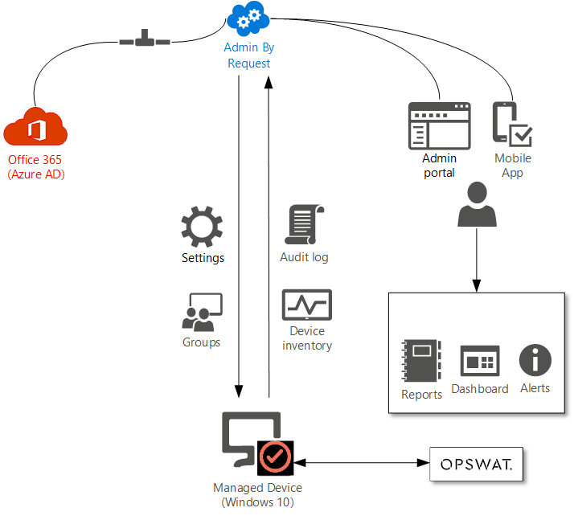
EPM - SSW Standard choice (add-on)

Slide 16
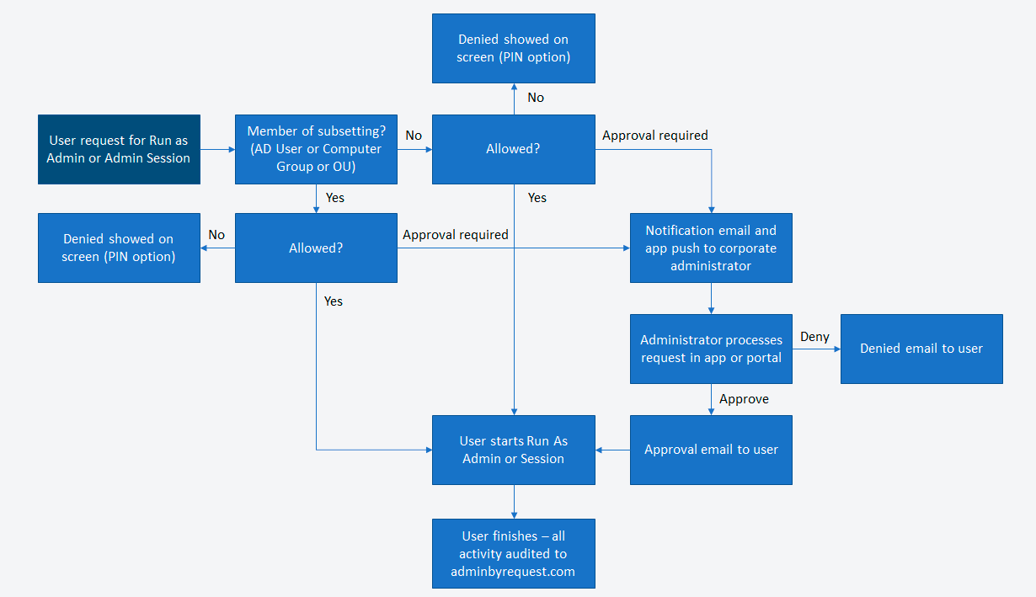
EPM - Approval flow

Slide 17
EPM - Insight & Reporting
Portal Account – using Office 365 credentials
Access to
Summary Dashboard
Reports
Audit log
Inventory
Detected Malware
Export reports to PDF, XLSX or CSV

Slide 18
SSW – EPM
Onboard & Configuration

Slide 19
SSW EPM – Onboarding
Tenant setup
Creation of the tenant and tenant admin account
Connect to Azure AD (Office 365)
Create portal users
Admin role (Sogeti)
Report & Approver role (Customer rep)
Distribute Client with Intune
Windows Base Settings
Authorization (Run as Admin / Admin Session, Approval requirement)
Endpoint (Branding, Look and Feel, UAC Prompt behavior)
Lockdown (Remove admins, application blacklist)
Malware (Real-time detection, Cloud scan)
Application pre-approval (‘Whitelist’)
Data privacy settings
Email integration

Slide 20
SSW EPM – Standard roles
Standard users (low flexibility)
Can request Run as Admin only
Need to request approval for each Run As Admin elevation
Cannot elevate system files (cmd.exe, PowerShell.exe)
Power Users (medium flexibility)
Can request Run As Admin only
Do not need to request for approval but must specify a reason
Can elevate system files
Developers / IT Admins (high flexibility)
Can request Run As Admin and Administrator Sessions
Do not need request for approval or specify a reason
Can elevate system files

Slide 21
SSW EPM – Additional configuration (Global)
Approval notification
One or more email addresses to notify for approval requests
Branding
Branding with customer logo’s, look and feel
Code of Conduct
Email templates
Data privacy
By default, the following information is gathered:
Usernames, user email addresses, inventory
The following information is optional, but turned off by default:
Geo tracking, user phone numbers
Optionally, user accounts can be aliased (anonymized) – not recommended
Retention of data, 1 year by default with a minimum of 3 months and max of 5 years

Slide 22
SSW EPM – Additional Configuration (scoped per role)
Application Blacklist (Customer specific – no entries by default)
Block single file, vendor files, files in location or always from run as admin
Single file or ‘Block Always’ require additional conditions (location, certificate, checksum)
Pre-approved applications (Customer specific – no entries by default)
Pre-approve applications per application, vendor-certificate or (read-only) location

Slide 23
SSW EPM – Additional Configuration (optional)
API access
Collect Audit logs, Inventory and Requests and offload to SIEM
Approve or deny requests using API integration
Integration with ticketing system
Email based integration with your ticketing system
Support for macOS or Server Editions
Requires separate licenses and configuration

